Slide 1
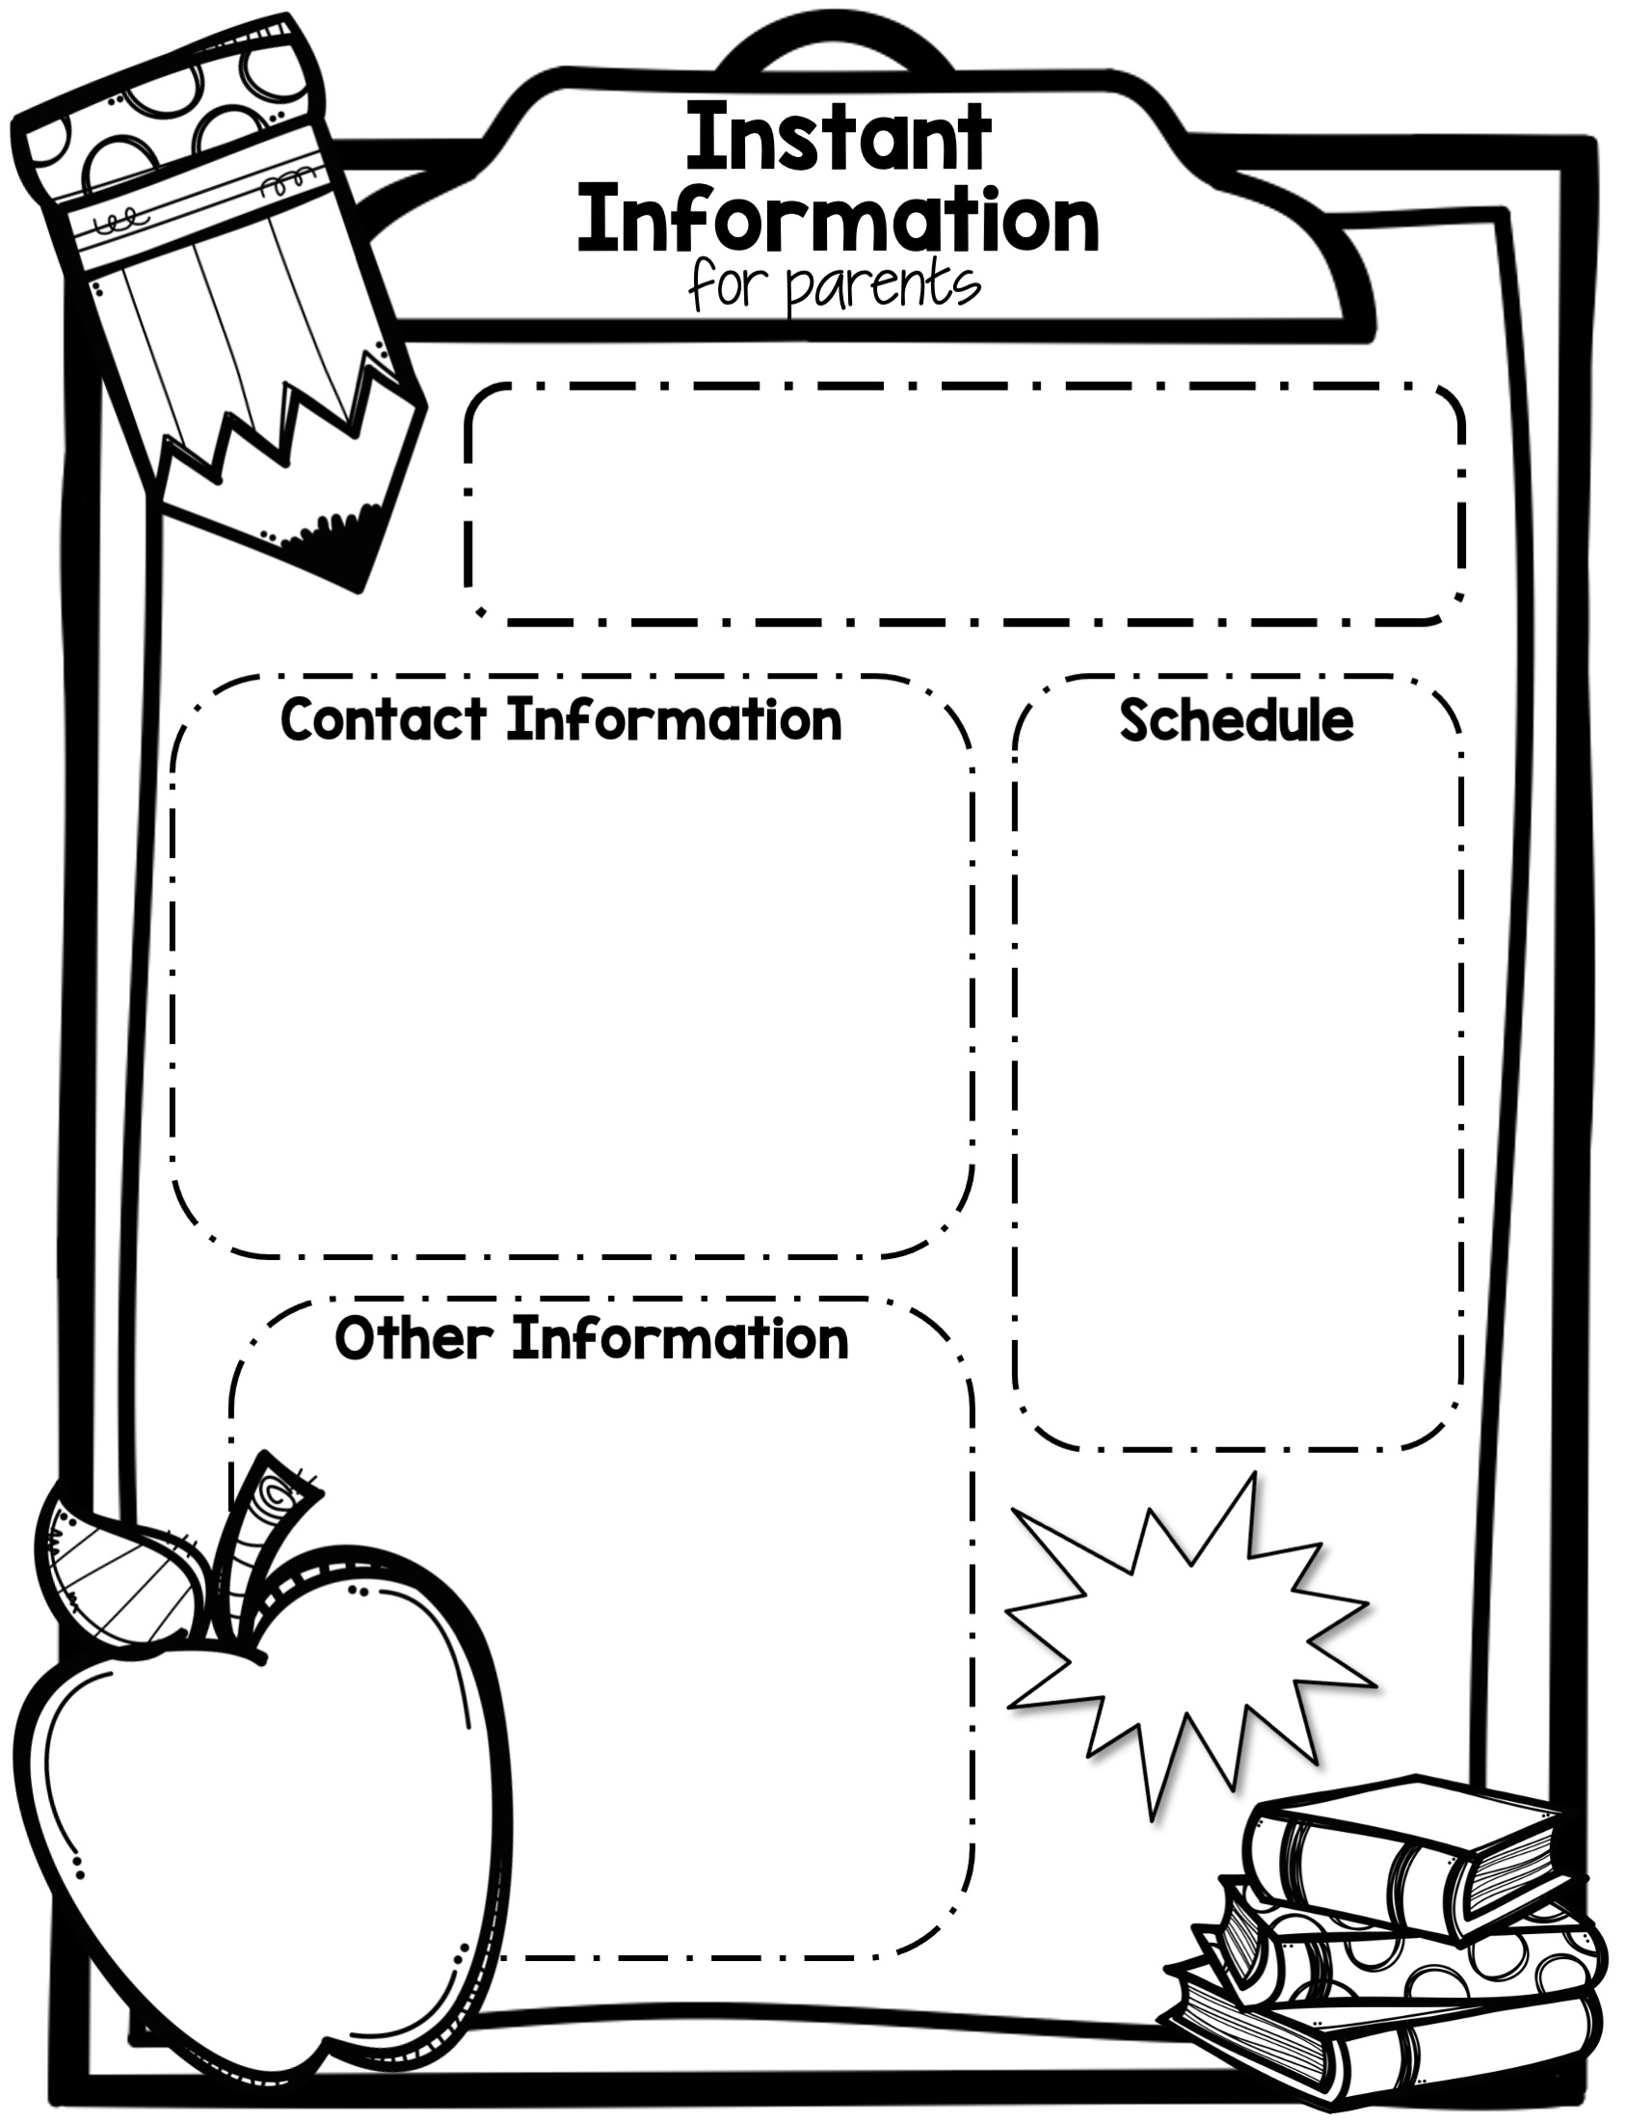
Mrs. Lewis Class
5th Grade
Room B107
Time | Subject
9:20-9:45 | Morning Meeting
9:45-10:15 | Math Direct Instruction
10:15-11:00 | Science/ Social Studies
11-11:50 | Lunch/Recess
11:50-1:20 | ELA
1:20-1:50 | MTSS
1:55-2:50 | Math Small Groups/DI
2:50-3:20 | Specials
3:20-3:30 | Pack Up/Clean Up/Dismissal
Ana.lewis@bristoltwpsd.org
-OR-
Message me on Talking Points!
Specials
A Day- Gym
B Day- Library
C Day- Computers
D Day- Art
E Day-Music
Keep
in
Touch!
5th Grade
Rocks!

